Slide 1
DOT FHWA Secure Data Commons
09/15/2019
SDC Demo

Slide 2
Purpose
To explain the SDC environment
To provide a brief overview of the onboarding process
Demo accessing SDC, importing data, analyzing data and exporting data
Common FAQ
Notes:
Deepak
Team introduction?

Slide 3
What is the SDC?
The Secure Data Commons (SDC) is an online data warehousing and analysis platform for transportation researchers. On this portal, researchers can take advantage of pre-established programming environments to access and analyze a growing set of transportation-related data sets.
Provides secure access to data and enables the ability to conduct research and analysis on these data sets
Security of Data - Moderate level
Designed for analysis using programming and statistical tool packages
Analysis is performed within the SDC platform through cloud-based resources
The SDC platform is being developed as a collaborative environment for traffic engineers, researchers, data scientists, and anyone who is interested in carrying out research and analysis on different datasets related to traffic, weather, crashes, and others.

Slide 4
Benefits
Built in architecture for storing and managing data
Built in architecture for data analyst teams roles
Ability to rapidly access research data sets for analysis
Near-real time data flows
Controlled access to data provides comfort for data providers.

Slide 5
Users
Projects
Data Providers
Data Analyst
A project is a pairing of Data Providers and Users
Project Managers must evaluate costs from all three standpoints to assess their need to use the SDC. Costs are provided in three categories:
Cloud Consumption
IT Services
Enablement
Data Providers can provide data in near-real-time, batch uploads, and ad-hoc uploads
Data Providers can develop common data formats and fix issues during testing
Data Providers define the terms of data access and can grant or deny access to specific users or groups.
Data Providers can grant or deny access to what type of derived data is exported or copied from the system.
Data Analysts work within the SDC Analytic Sandbox. Each Analyst is provided a cloud-based workstation with pre-loaded programming environments and software. The workstations include access to data in the data lake and data warehouse. Data Analysts can…
share code and data with each other
upload their own datasets

Slide 6
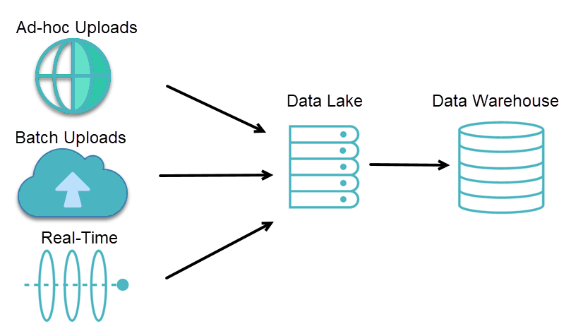
DATA FLOW: Data Provider
Data Lake
"Raw" data
Can be loosely structured
Variable frequency
AWS S3 buckets
Data Warehouse
Curated data - "lightly" to "highly
Subset of data lake data
Various technologies

Slide 7
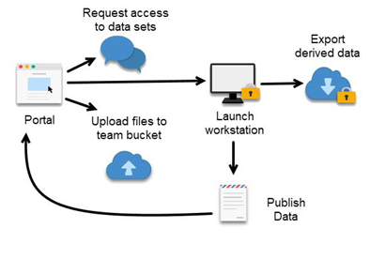
DATA FLOW: Data Analyst
Data Analysts are
Provisioned cloud-based workstations within the SDC
Each workstation comes with pre-loaded programming environments and software
The workstations include access to data in the data lake and data warehouse
Data Analyst can

Slide 8
Onboarding process
Onboarding a user to the SDC system involves the following steps:
User Request
Access Request review
Email Instructions
Walkthrough of the system
Workstation Access
Check In
Detail onboarding instructions located: https://portal.securedatacommons.com/faqs

Slide 9
Demo – On SDC Workstation
Demo
Accessing web portal
Workstations start/launch/stop
Import data
Analyze data
Export data
Collaborate
Applications available

Slide 10
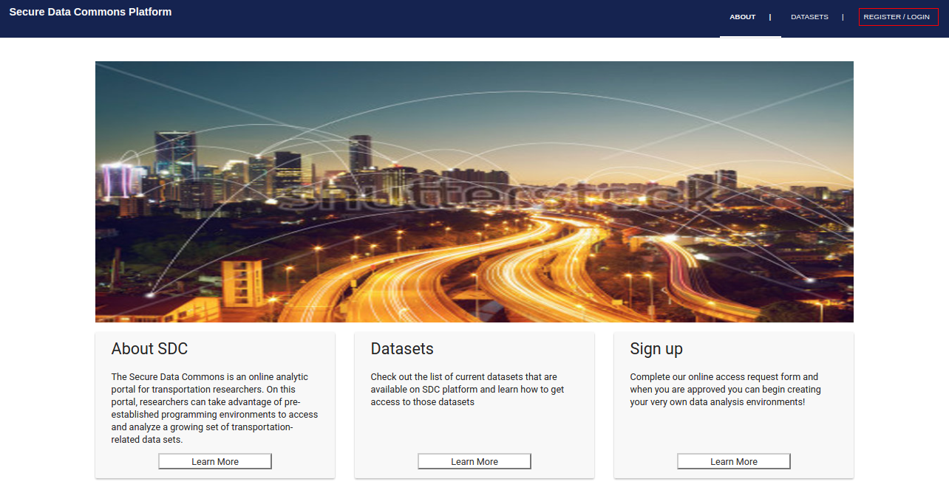
Access portal
Go to https://portal.securedatacommons.com
Go to ‘Register/Login’ menu tab

Slide 11
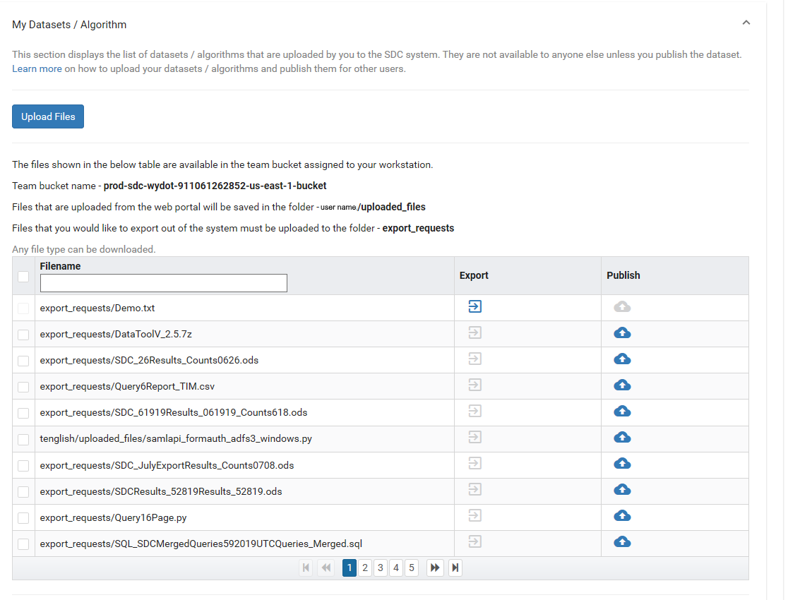
Import data
Select data to import
Curated datasets
Raw datasets
Published datasets
Verify through s3 browser

Slide 12
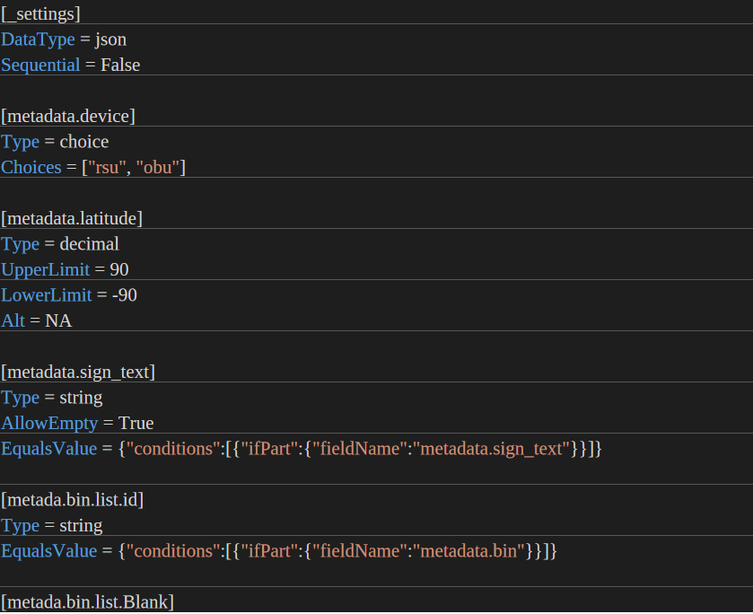
Validation of data – Canary Function
Canary function
What is this?
A sanitization process that validates the content of data provided by Data Providers by using client generated configuration files.
Why is it important?
This process will find problems within data generation on the Data Providers and in the SDC infrastructure.
What is a sample .ini/validation file? (CSV/JSON)
Validate data or failed data imports?
https://console.aws.amazon.com/cloudwatch/home?region=us-east-1#dashboards:name=prod-validator-summary

Slide 13
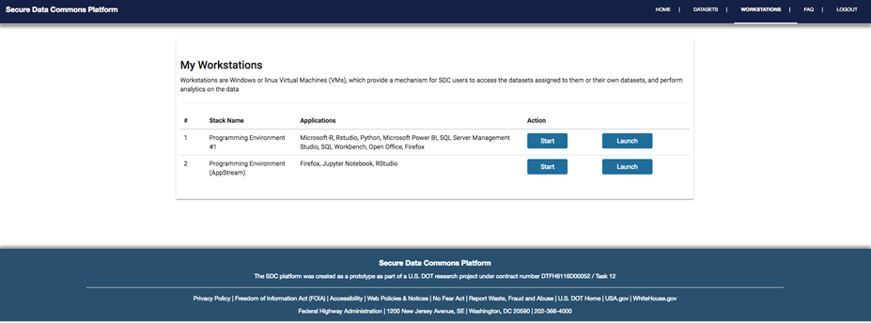
Analysis
Upload your own data
For individual or team use
Derived Data
Results of analysis
Can be shared for individual or team use
Can request exports from Data Provider
Analytical Tools
Virtual Machine Instances
Can easily scale up for bigger analytical problems
Standard Software
E.g. Python, RStudio, SQL
Analyst Specific Software

Slide 14
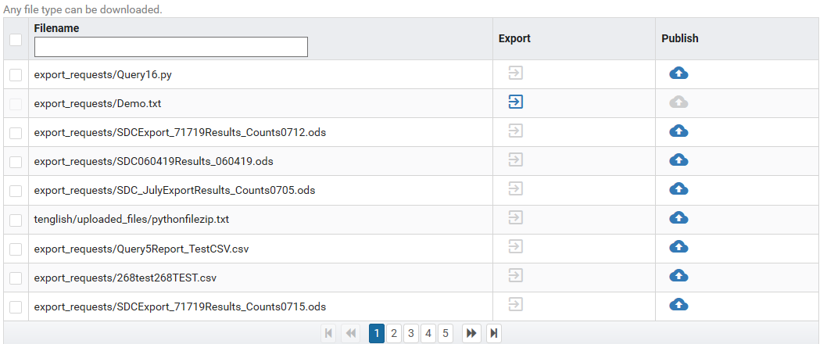
Export data
Select data to export
Export from portal
View exported data

Slide 15
Management Tools
Confluence Project Dashboard
Backlog to Users Stories, features
Meetings
Personas
High Level Roadmap
Support Functionality
Quarterly Newsletter/Meetings
Release Notes
Frequently Asked Questions
Support Tickets sent to SDC Admin email and process in our JIRA visible to you as the end users
Notes:
Jen

Slide 16
Q&A and FAQ
Why cant I access my favorite websites?
Why cant I cut & paste
Why cant I go to Git Hub?
Other FAQ:
https://portal.securedatacommons.com/faqs

Slide 17
Secure Data Commons Website
Learn more about the SDC from our Website
https://its.dot.gov/data/secure/index.html

Slide 18
Questions

